Slide 1

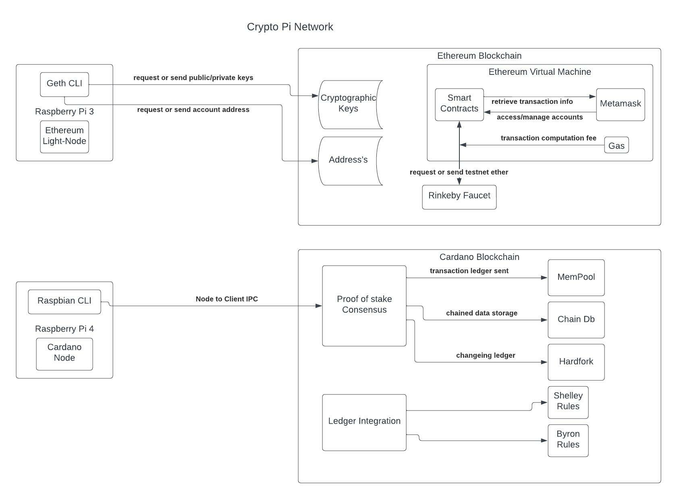
Crypto Pi NetWork

